Slide 1


HTML (Hypertext Markup Language)
Basics of HTML

Slide 2

What is HTML?
HTML is a markup language used to create the structure of web pages.
A website can be created by linking together individual pages.
HTML is styled and scripted using technologies such as CSS and JavaScript.

Slide 3
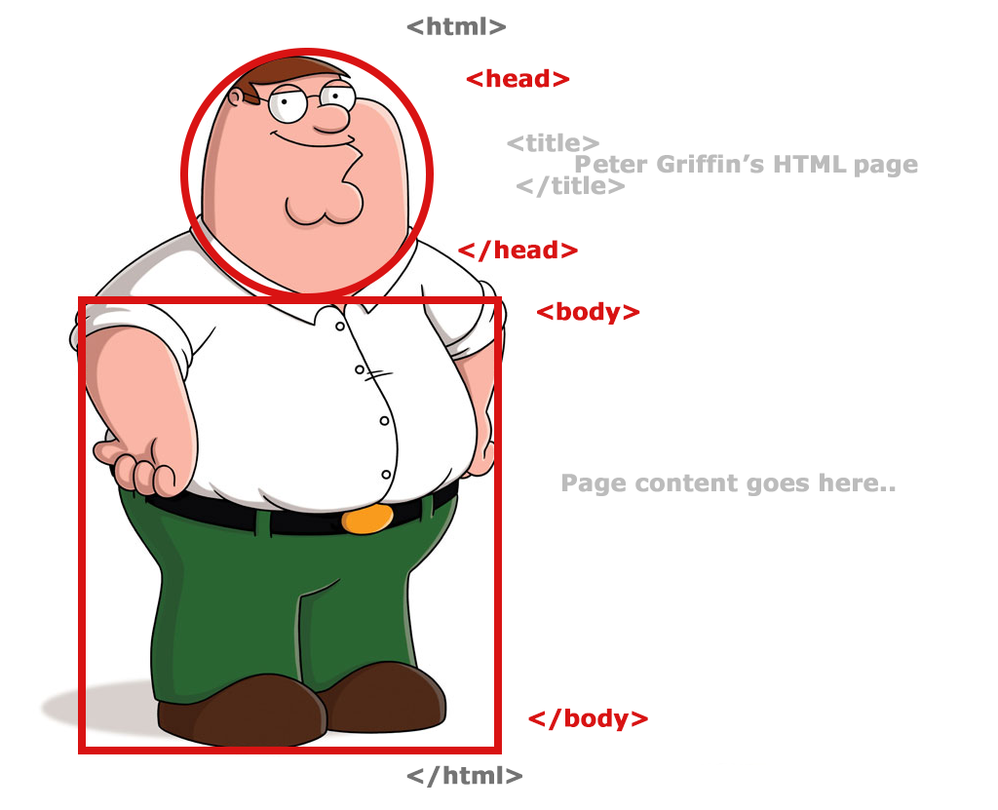
Structure of HTML Document
The structure of an HTML Document can be compared to ours…

Slide 4


Structure of HTML Document
<html element>
<!DOCTYPE html>
<html>
<head>
<meta charset=“UTF-8”>
<title>Job Portal</title>
</head>
<body>
<h1>Hire Me Now!</p>
<p>Best Place To Find Your Dream Job.</p>
</body>
</html>
<head element>
<body element>

Slide 5
The <head> Element
Used to add external resources such as style sheets and scripts.
Contains information about the document
This section’s contents are not rendered on the web page
<title> is an important element in <head> section.

Slide 6
The <body> element
Contains structure and contents visible on the web page.
<body>
<h1>…</h1>
<p>….</p>
</body>
Includes elements like text, images and links.
<div> and <span>, <h1> - <h6>, <p>, <a>.

Slide 7
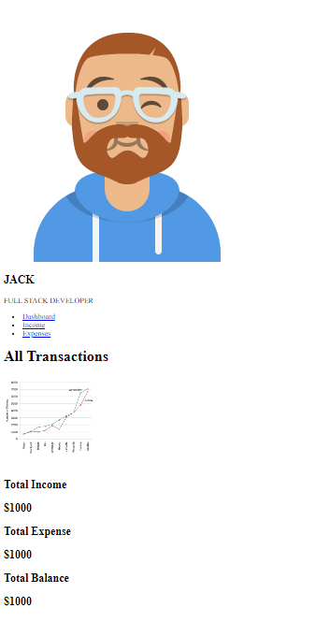
<p> is the paragraph tag, where we write the paragraph.
The <a> tag defines a hyperlink, which is used to link from one page to another.
Heading tags are those <h1> to <h6> tags, used to write headings.

Slide 8
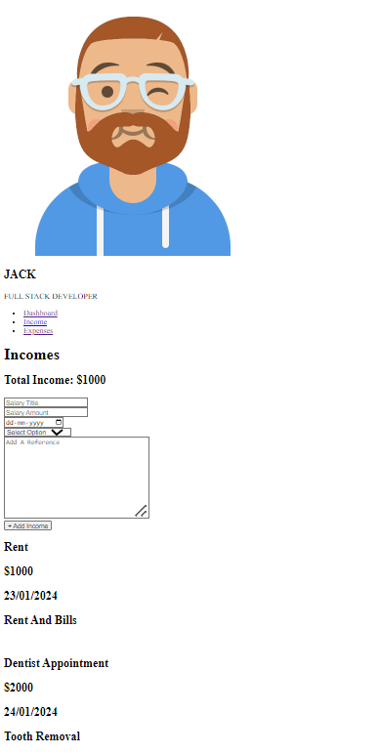
The <img> tag is used to embed an image in an HTML page.
The HTML <form> element is used to create an HTML form for user input
The <form> element is a container for different types of input elements, such as: text fields, checkboxes, submit buttons, etc.

Slide 9
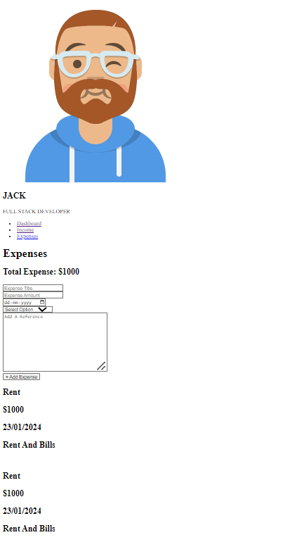
An unordered list starts with the <ul> tag. Each list item starts with the <li> tag.
The list items will be marked with bullets (small black circles) by default

Slide 10


